Slide 1

Translatish
NLP Project
(CSC306)
Guided by
Prof. Jaideep Raulji
Prof. Vinay Vachharajani

Slide 2
Team Members
Enrollment No. | Name
AU1841004 | Aanshi Patwari
AU1841052 | Dipika Pawar
AU1841057 | Mayankkumar Tank
AU1841076 | Rahul Chocha
AU1841125 | Yash Patel

Slide 3

Introduction
As in our country India, the national language is considered to be Hindi and it is spoken all over the country, translation of any videos into Hindi can help reach maximum audience.
So, to reach a wider audience and make videos available in other languages, we decided to translate the English language videos into Hindi
language.
Video translation includes transcription, translation,
subtitling, and voice-overs.

Slide 4
Steps involved
Step 01
Step 02
Step 03
Step 04
Step 05
Upload Video
V/A conversion
A/T extraction
Machine Translation
Display output
Upload video in English language
Input video is converted to audio form
Text is extracted from the audio
Display the Hindi text output on screen
English text is translated to Hindi text

Slide 5
Project Model Flow
Dataset Collection
Data preprocessing
Removal of duplicate and null records
Conversion to lowercase
Removal of Quotes, Special characters and extra spaces.
Model implementation
Model Evaluation
Working End Product (Model Deployment)

Slide 6
Challenges and solutions to the problems
- Related to Platform
Different versions not supporting each other’s versions so had to rebase all to a common version adaptable and working for all.(E.g:- TF=2.0.0, Keras=2.1.5)
Setting the parameters for the model(for speeding up the model building process)
RAM crash error due to running the code onto the whole dataset. So we tried to implement the code on a part of the dataset.
Shift from the Google Colab to Kaggle Notebook as it provides more space and RAM as compared to colab which increased the computation speed to a larger extent.

Slide 7
Challenges and solutions to the problems
- Related to model testing & deployment
Need of Pre-processing of the testing dataset according to our model
Merging with backend in end product will leads to error related to version dependencies. So, we have to tune the frontend and backend technology versions. (Changing from python3.7 to python3.5 and django and reactjs versions and also rest API)
Hosting on AWS Lambda allows 50 MB while our data and weights file exceeds 100 MB which hampers it’s deployment on Heroku too.
AWS S3 required AWS credits for cloud instances and buckets storage which exceeded our free tier student account limit.

Slide 8
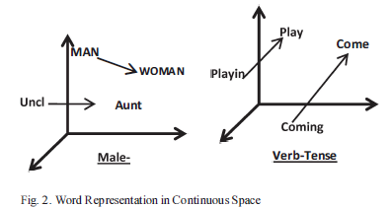
Literature Review
Article 1:- Machine Translation using Deep Learning : An Overview
Use of RNN(Recurrent Neural Network) to reordering for source to target language by the use of semi-supervised learning methods.
Word embedding is used to generate the vector value of the words which can be used for translation purpose.
Use of binary tree structure for mapping the word in the target language with the vector values of the source language.
But RNN has a complex structure which turn in more computations so LSTM is more preferred over RNN.

Slide 9
Literature Review
Article 2:- Neural Machine Translation for English to Hindi
Sequence by sequence learning using LSTM.
Proposed NMT (neural network based machine translation) which has eight layers of encoders and decoders, Core Idea of NMT is to use Deep leading ideas.
Why NMT ? because it requires fraction of a memory compared to conventional models.
Bidirectional RNN as Encoder and Decoder.
Decoder used to predict words in a target sentences.
Encoder-Decoder models are jointly trained to maximize the conditional probabilities of the target sequence given the input sequence.

Slide 10
Literature Review
Comparison of LSTM and RNN
GRU values are also close to LSTM values with lesser run time in comparison to RNN.
The LSTM layer architecture is instead built in such a way the the network “decides” whether to modify its “internal memory” at each step.
Doing so, and if properly trained, the layer can keep track of important events from further in the past, allowing for much richer inference.
LSTM networks were made with one purpose in mind — to solve long term dependency problems that traditional RNNs have.
LSTM networks are specially made to solve long-term dependency problems in RNNs and they are super good at making use of data from a while ago (inherent in its nature) by using cell states and RNN has a complex structure which in turn has more computations therefore making LSTM more preferred over RNN.

Slide 11

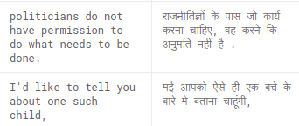
About Project Corpus - HindiEnglishCorpora
Bilingual corpora
Part of parallel corpora which contains multiple corporas.
Taken from about 37726 TED talks, news articles, Wikipedia articles.
Has unique 1,24,318 english records and 9,7662 hindi records
Corpus link: HindiEnglishCorpora
Cleaned dataset
It is sentence tokenized (sentence aligned)

Slide 12
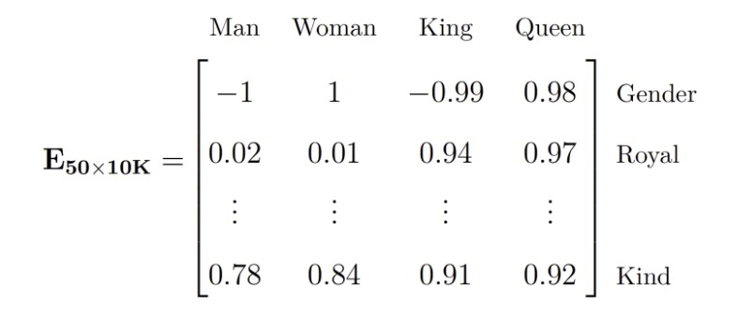
Word embedding
Source : https://medium.com/analytics-vidhya/neural-machine-translation-for-hindi-english-sequence-to-sequence-learning-1298655e334a

Slide 13
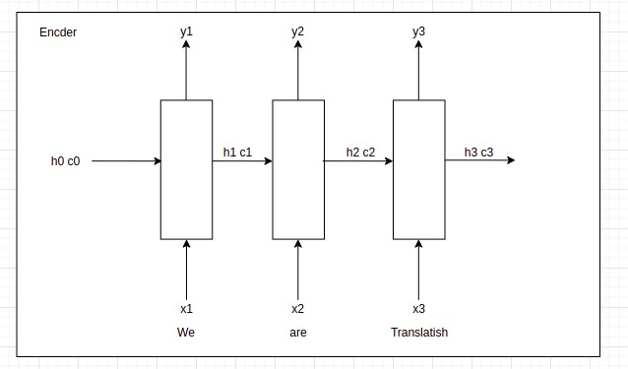
Structure of LSTM Encoder

Slide 14
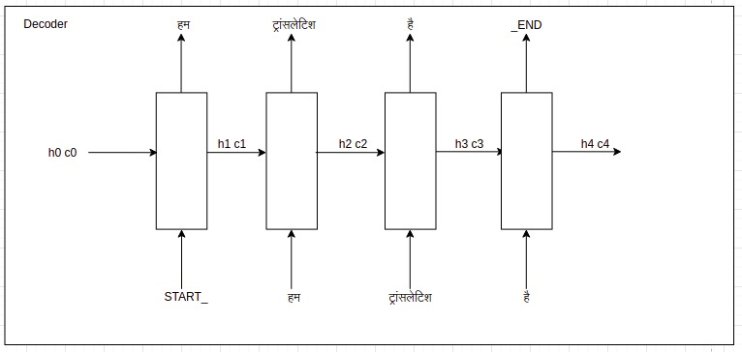
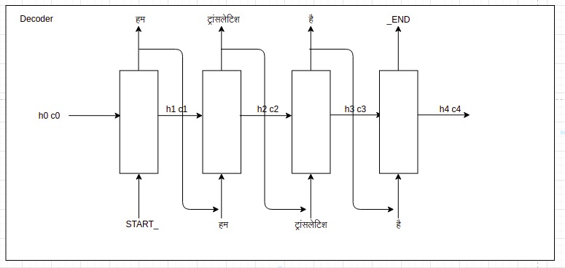
Structure of LSTM Decoder
Training Decoder
Testing Decoder

Slide 15
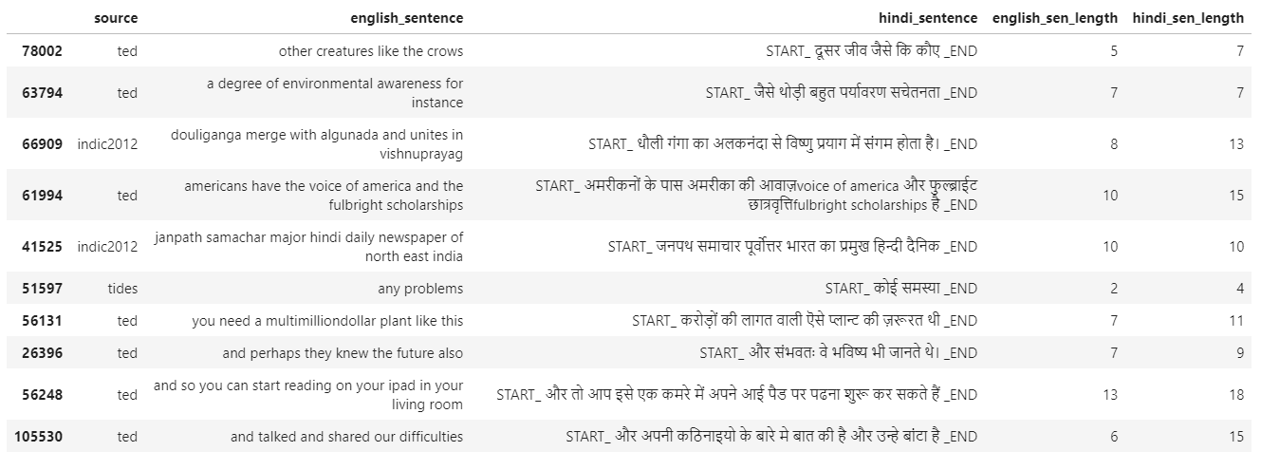
Results
Output data after Cleaning and Preprocessing

Slide 16
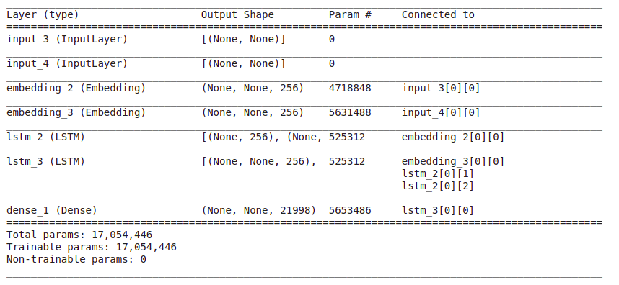
Results
Model Summary

Slide 17
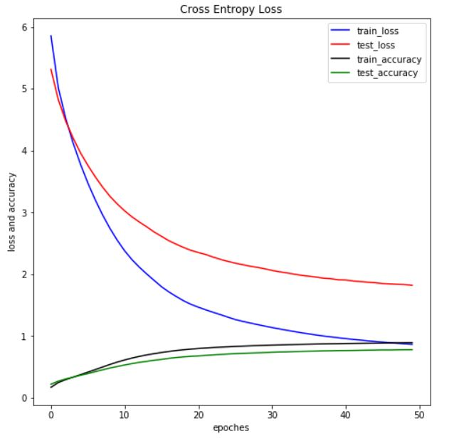
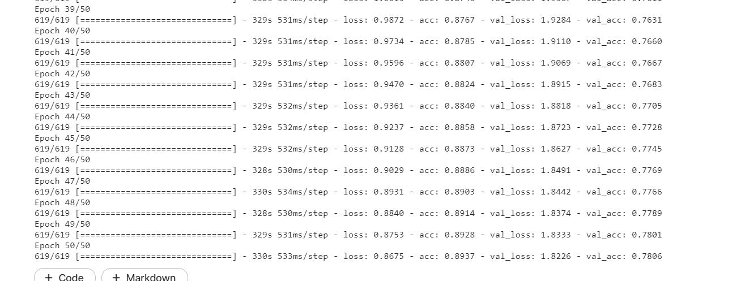
Results
Model Training-Validation:

Slide 18
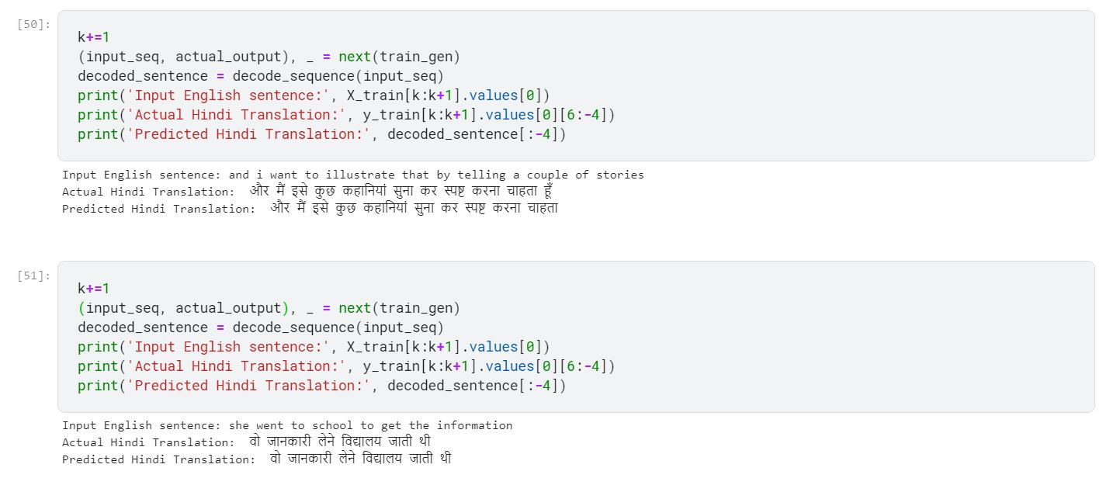
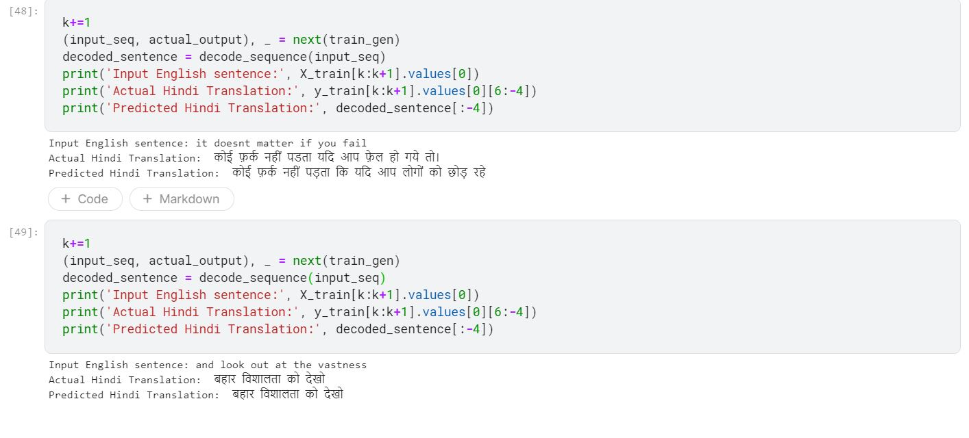
Results
Model Testing:
Image 1
Image 2

Slide 19
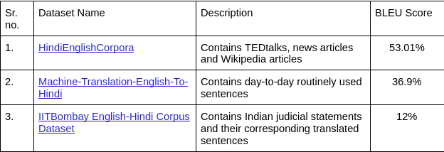
Results
Bleu Score Computation with different dataset

Slide 20
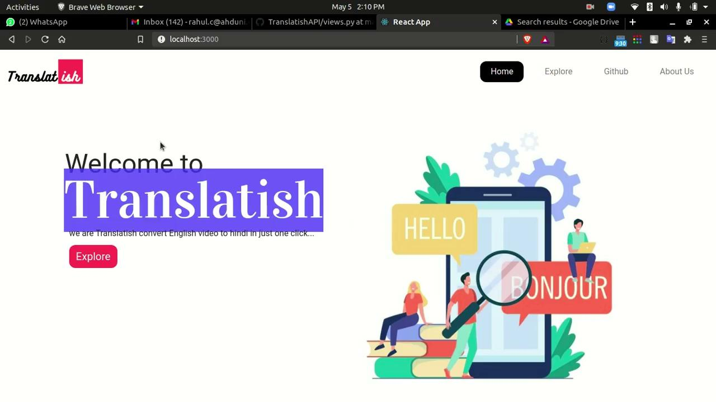
Results
Working end product (Web-app)

Slide 21
Future Work
Try to more optimize the model
Implementation of proposed model on different datasets
Try out translation into other languages
Train the model on dataset for variety of sentences from different videos
Conversion of the translated sentences into video format
Improve the model performance by implementing it on super computers which can provide more efficient results and computation power
Change the speech to text conversion strategy

Slide 22
Contributions
Task/Name | Aanshi | Dipika | Mayankkumar | Rahul | Yash
Literature Survey | ✔ | ✔ | ✔ | ✔ | ✔
Data Collection and Preprocessing | ✔ | ✔ | ✔ | ✔ | ✔
Model Implementation | ✔ | ✔ |  |  | ✔
Error Solving and Model Optimization and evaluation | ✔ | ✔ | ✔ | ✔ | ✔
Model Testing | ✔ | ✔ | ✔ | ✔ | ✔
Frontend |  |  | ✔ | ✔
Backend | ✔ | ✔ | ✔ | ✔ | ✔
Documentation | ✔ | ✔ | ✔ | ✔ | ✔

Slide 23
References
Neural Machine Translation For English To Hindi
Machine Learning Translation using Deep Learning: An Overview
Dataset
seq2seq LSTM model
Encoder-Decoder LSTM model explanation
LSTM using TF Keras
Deployment

Slide 24
Thank you!
Notes:
Bleu - for accuracy

